Slide 2
There is freedom in the gospel
Galatians 4

Slide 3
What comes to mind when you think of freedom?
Being able to do what you want when you want
No rules (this is what I thought when I was a kid 😊)
To say what you want without consequences
Maybe you may even have the want to shout…. FREEDOM!!!! (in a Scottish accent)

Slide 4
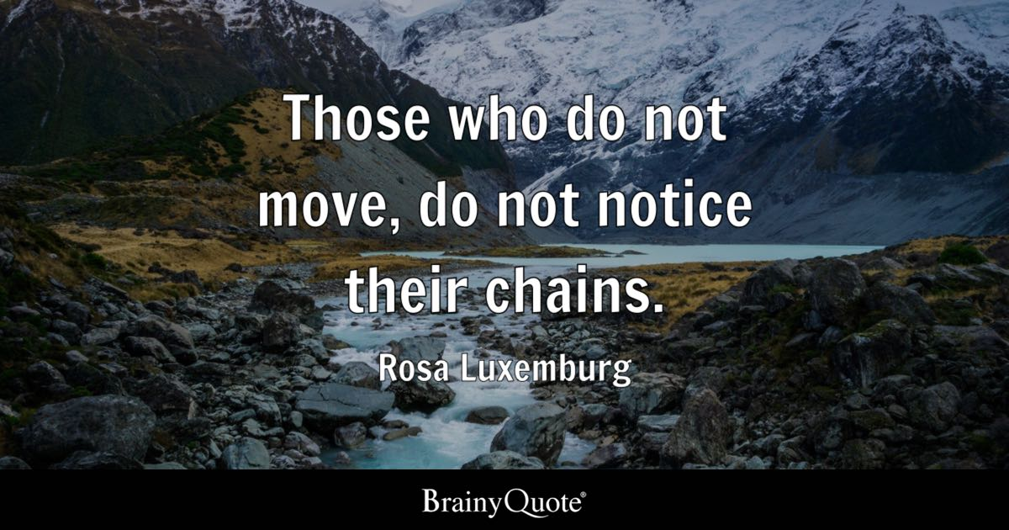

Slide 9
Galatians 3:13-14
Christ redeemed us from the curse of the law by becoming a curse for us—for it is written, “Cursed is everyone who is hanged on a tree”— 14 so that in Christ Jesus the blessing of Abraham might come to the Gentiles, so that we might receive the promised Spirit through faith.

Slide 10
1) Freedom in

Slide 12
First reaction
This was not the mood I was wanting right now!!!
But why?!?!
That’s not how I would have written it
Knew that was going to happen

Slide 13
Every story
Villian= devil
Hero=Jesus
This hero has some friends= disciples
The big battle= the cross
All seems lost but………..
Then the trumph

Slide 14
Galatians 3:26-29
or in Christ Jesus you are all sons of God, through faith. 27 For as many of you as were baptized into Christ have put on Christ. 28 There is neither Jew nor Greek, there is neither slave nor free, there is no male and female, for you are all one in Christ Jesus. 29 And if you are Christ's, then you are Abraham's offspring, heirs according to promise.

Slide 15
Slave to heir

Slide 16
Verse 4-6
But when the fullness of time had come, God sent forth his Son, born of woman, born under the law, 5 to redeem those who were under the law, so that we might receive adoption as sons. 6 And because you are sons, God has sent the Spirit of his Son into our hearts, crying, “Abba! Father!”

Slide 17
John 14:2-3
In my Father's house are many rooms. If it were not so, would I have told you that I go to prepare a place for you? 3 And if I go and prepare a place for you, I will come again and will take you to myself, that where I am you may be also.

Slide 18
Romans 8:15-17
For you did not receive the spirit of slavery to fall back into fear, but you have received the Spirit of adoption as sons, by whom we cry, “Abba! Father!” 16 The Spirit himself bears witness with our spirit that we are children of God, 17 and if children, then heirs—heirs of God and fellow heirs with Christ, provided we suffer with him in order that we may also be glorified with him.

Slide 19
The Lords prayer

Slide 20
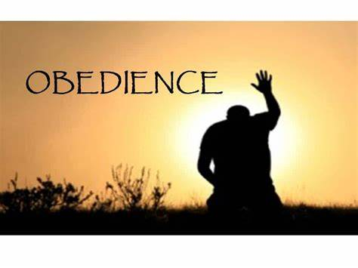
2) Freedom in

Slide 21
What word or phrase that if said right now, would feel you with fear?

Slide 22
Verse 7-9
7 So you are no longer a slave, but a son, and if a son, then an heir through God. Formerly, when you did not know God, you were enslaved to those that by nature are not gods. 9 But now that you have come to know God, or rather to be known by God,

Slide 23
Know and known

Slide 24
Verse 9-10
9 But now that you have come to know God, or rather to be known by God, how can you turn back again to the weak and worthless elementary principles of the world, whose slaves you want to be once more? 10 You observe days and months and seasons and years!

Slide 25
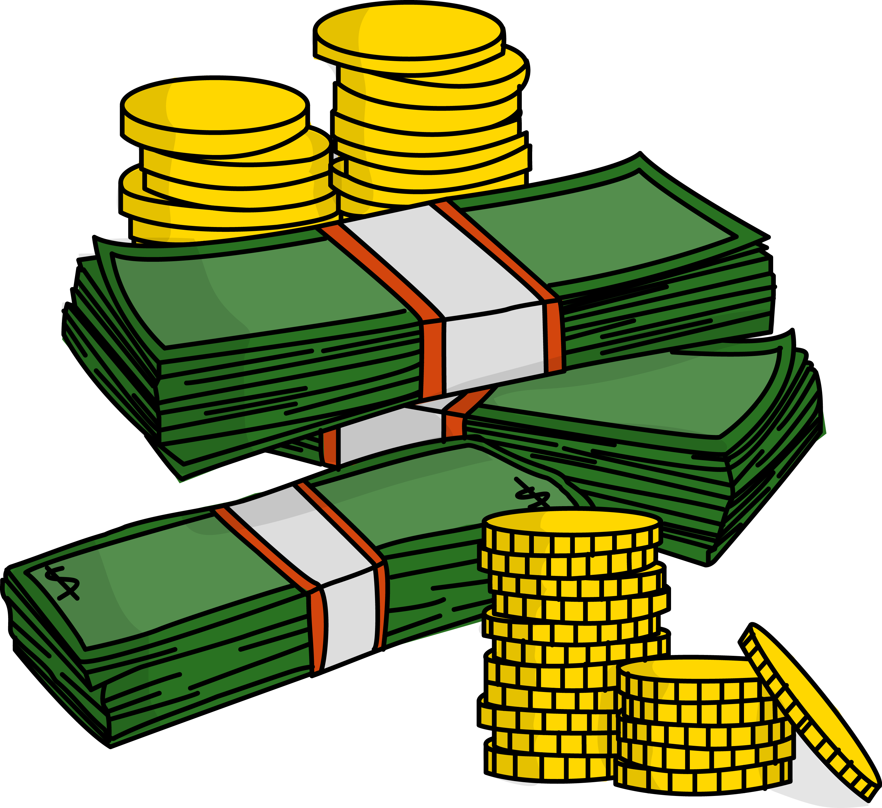
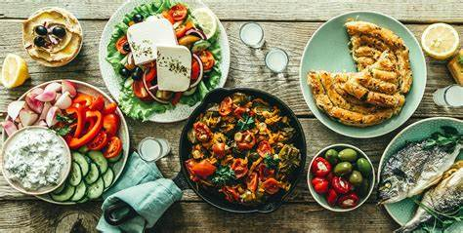
how often do we turn to things like:
The gym (preaching to my self here)
TV
Drink
Work colleges
Approve of people
Money
Our dreams
Wanting control in everything
Food etc

Slide 26
Galatians 5:1
For freedom Christ has set us free; stand firm therefore, and do not submit again to a yoke of slavery.

Slide 28
Freedom vs biblical freedom

Slide 30
Luke 4:18-19
“The Spirit of the Lord is upon me, because he has anointed me to proclaim good news to the poor. He has sent me to proclaim liberty to the captives and recovering of sight to the blind,to set at liberty those who are oppressed, to proclaim the year of the Lord's favor.”

